Slide 1

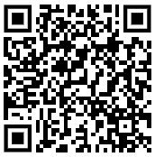
Leeds Summer Schools 2026
Opportunity for Year 12 students to explore a chosen subject area
and experience what it’s like to live in and learn at Leeds:
Biosciences: 25–26 June
Food Science & Nutrition: 30 June–2 July
Languages – Linguastars: 23–25 June
Social Sciences: 23–25 June
Applications for all summer schools close on Tuesday 7 April 2026.
There may be a contribution towards travel costs for
eligible students. Visit the website to find out more.

